Slide 1
Inteligent Systems
Robocode by denis, kacper and kirill.

Slide 2
Describing classes.
There are 5 classes in this project.
RouteFinder is the main class that runs the Robocode from eclipse
There are 4 classes that are responsible for the robot itself.
Cell class
Direction class
EvaluatedCell class
MazeBot class
We will describe what each of the class does in the following slides.

Slide 3
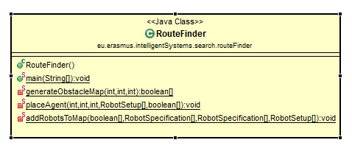
RouteFinder Class
Firstly we create the engine with a random seed that was made up and using the code provided.
We create obstacles and place them at random on the map.
We create an agent, which is placed at random on the map.
There are 3 methods following the building of map and agent
Generate Obstackle map which takes the seed and generates a map to be of fixed Int size.
Place agent which places the agent at a random place on the map.
Add Robots to Map method adds the ducks to the map.

Slide 4
Cell Class
This class sets the current row and cell
Comparable to the others Cells.
Rows and collums are a fixed amount of points on the map

Slide 5
Evaluated Cell Class
The Evaluated Cell puts in the functionality into the Cell class, this class is used for the A* algorithm. The evaluated cells are all the cells that the robot was at and also the candidate cells which are other cells that could have been used, but the cost or evaluation was not efficient.
The evaluation is consisting of the cost and the estimation.
The length of the shortest path from the start position is the cost
There is a compareTo method used to match the best candidate
In the class we store the optimal path(from starting cell to the current EvaluatedCell) as sequence of Cells.

Slide 6
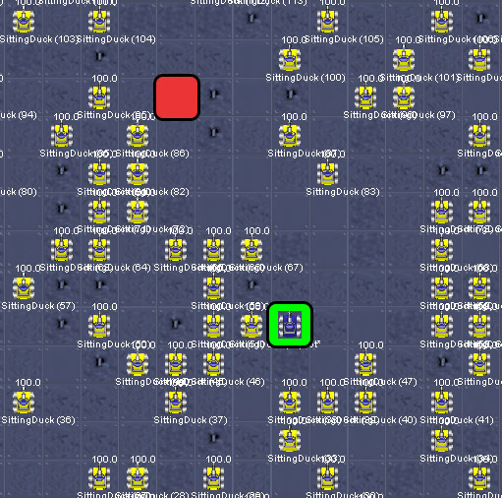
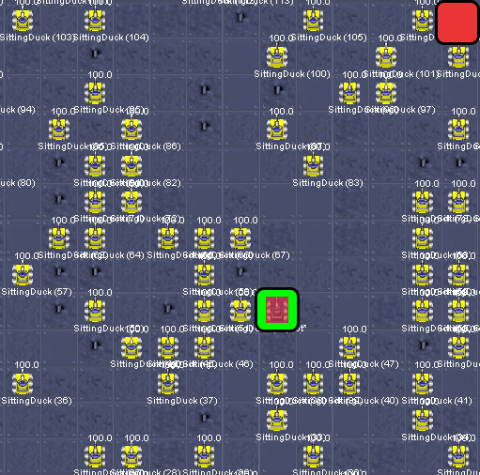
Normal scenario
Our obstacles are generated randomly hence why we are not sure that there will be solution.
This is because these random obstacles can block the path to the final point.
In the program if the solution doesn’t exit we set a red color of a robot and the robot does not move.

Slide 7
Data structures
Manhattan distance from the goal state: to store Manhattan distance from each cell to goal instead of using a Two-Dimensional Array, we use a Single Dimensional Array to avoid a lot of complexity
PriorityQueue<EvaluatedCell> , Another structure that is important for our problem.
Thanks to this structure we can match the best candidate for the next step.
The head of the queue is found by using the queue.poll, which shows the best candidate.
At the start we have an Array which we initialized with information about sitting ducks. This is because it is not necessary to calculate the Manhattan distance for them. They are closed by default, due to the fact that they can’t be discovered.
Manhattan distance then calculates estimation for every cell and when the cell is chosen it becomes closed.
We don’t store that information in the Cell class, so we don’t have to create as many objects as the amount of free cells in case that the final path is short.

Slide 8
Direction Class
The robot has to move in some direction.
This class makes sure the robot moves in headings of 360 degrees.
The robot can only move Up, Down, Left , Right
Every direction have assigned values for a degree.

Slide 9
Robot moves
Robot moves based on the Direction class, it’s used for comparing the current direction to the cell where the robot has to move.
The start orientation for the robot is Up(0) then the robot is exploring the next cell.
The robot runs based on a findRoute path.
If no path is found the robot will turn red.
We implement a changeOrientationByNextPosition method so that the robot moves naturally- it doesn’t turn more than 180 degrees.

Slide 10
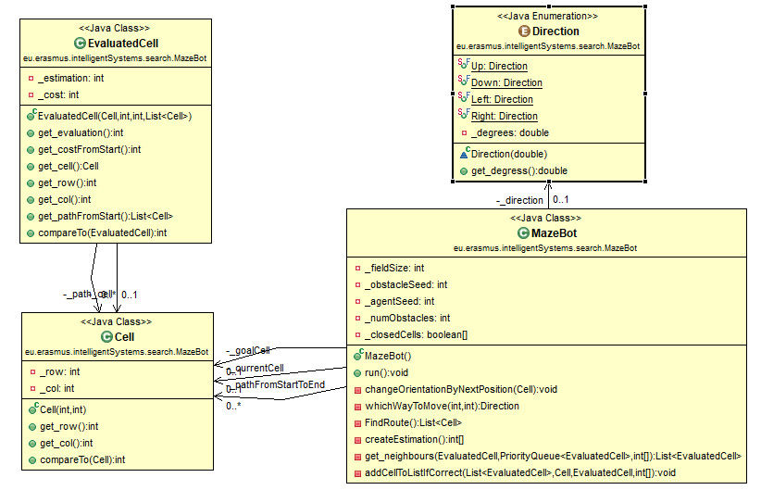
Class Diagram

Slide 11
Any questions?

